Slide 1
Compact body interactions and Boson Stars
Jacksonville, 15 April 2007
Carlos Palenzuela⁽¹⁾, I.Olabarrieta⁽¹⁾,L. Lehner⁽¹⁾,S. Liebling⁽²⁾
with contributions from
M. Anderson⁽¹⁾, D. Neilsen⁽³⁾, E. Hirschmann⁽³⁾
⁽¹⁾ Louisiana State University (Baton Rouge, Louisiana)
⁽²⁾ Long Island University (Long Island, New York)
⁽³⁾ Brigham Young University (Provo, Utah)

Slide 2
Overview
What is a boson star?
Motivation
Details of the numerical simulations
1) The head-on collision
2) The orbiting binary system
Future work

Slide 3
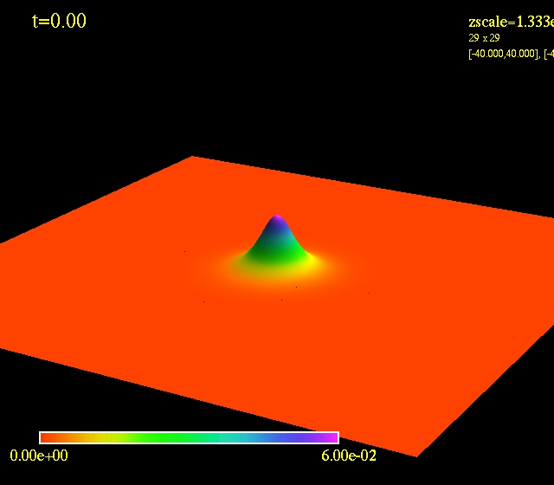
I. What is a Boson Star?
Boson Star: compact body composed of a complex massive scalar field
φ = φ₀(r) e^{-iωt}
φ₀
□ φ = m² φ KG eq.
R_{ab} = 8π (T_{ab} – g_{ab} T/2) EE
→ KG eq. does not form shock
→ the equation of state is given by the interaction potential

Slide 4
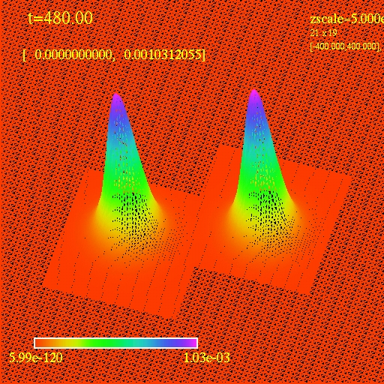
II. Motivation: The 2-body interaction
Evolution of 2 boson stars
a) interaction of the scalar fields → look for imprints on their GW radiation that can constraint their existence with the GW detectors
b) study common features of the 2-body interaction in GR
- Head-on collisions
- Orbiting binary systems

Slide 5
III. Details of the simulations
Equations & Initial Data
- Generalized Harmonic formalism of the Einstein Equations
- First order reduction of the EKG system in space and time
- ID : superposition of single Boson Stars
Numerical scheme
- Method of Lines with 3rd order Runge-Kutta
- 2nd Order Finite Difference space discretization
Implementation: had infrastructure
- Parallelization
- Adaptative Mesh Refinement in space and time

Slide 6
IV. Head-on collision (I)
Study the interaction of different cases and their imprint on the gravitational radiation (PRD 75, 064005 (2007))
ε = ± 1 : boson/antiboson
δ : phase difference
φ = φ₁(r – r₁) e^{-iωt} + φ₂(r – r₂) e^{-i(εωt+δ)}
Configurations
Boson/boson pair : ε = +1, δ = 0
Boson/antiboson pair : ε = -1, δ = 0
Boson/boson in op.
of phase pair : ε = +1, δ = π/2
L=50
R=27
m₁=m₂=0.26

Slide 7
V. Head-on collision (II)
Trajectories of the different cases and the (L=2 spherical harmonic modes of the) Ψ₄
BopB
Boson/boson
(BB)
Boson/antiboson
(BaB)
Newtonian
BB
BaB

Slide 8
VI. The binary orbiting system (I)
Configurations
Boson/boson pair : ε = +1, δ = 0
Boson/antiboson pair : ε = -1, δ = 0
L=32
R=12
m₁=m₂=0.50
ω=0.08

Slide 9
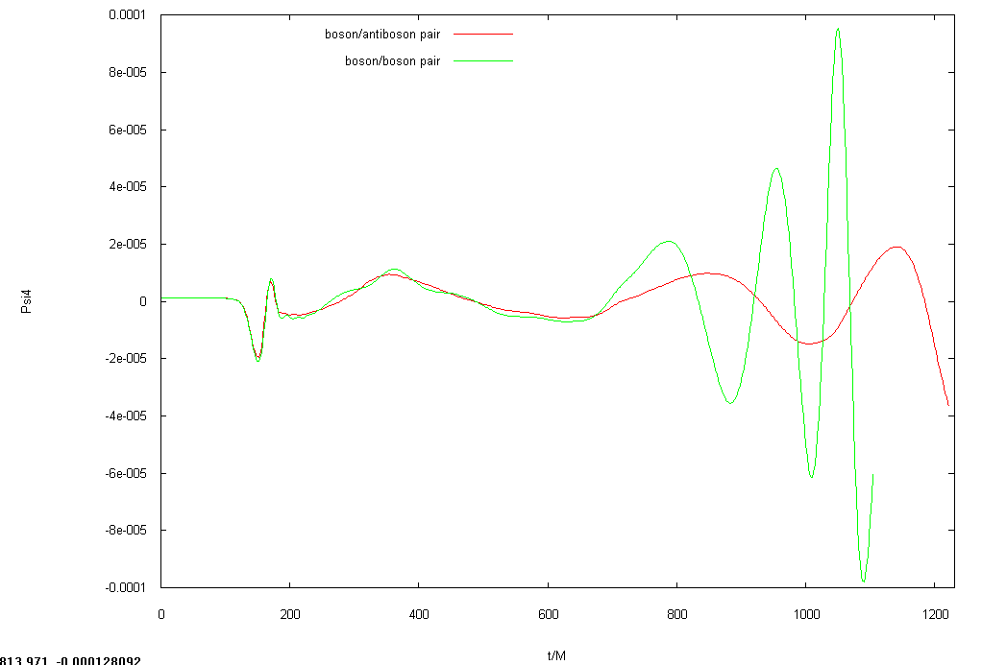
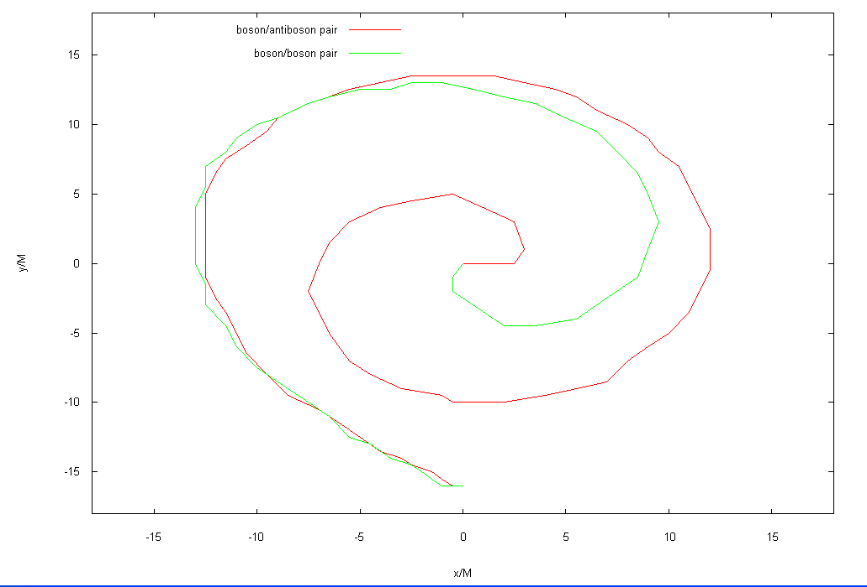
VII. The binary orbiting system (II)
Trajectories of the boson/boson and boson/antiboson pairs and the (L=2,M=2 spherical harmonic of the) Ψ₄
BaB
trajectories
L=2,M=2 mode of Ψ₄
BB

Slide 10
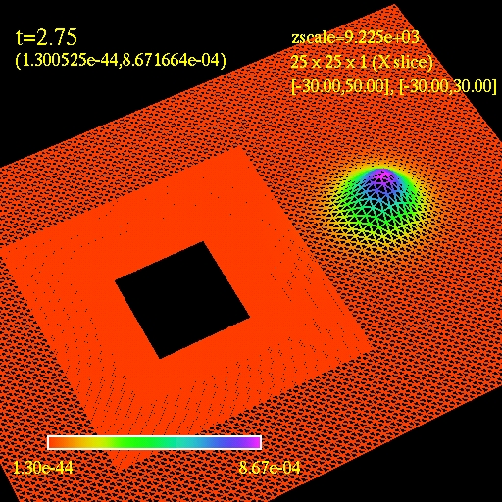
VIII. Future work
Compare the previous cases with orbiting binary Neutron Stars, BHs and Post-Newtonian results.
Study the BH + BS case
Study the dependence of the waveforms with the compactness of the bodies (M/R)
BH + Boson Star

